Slide 1
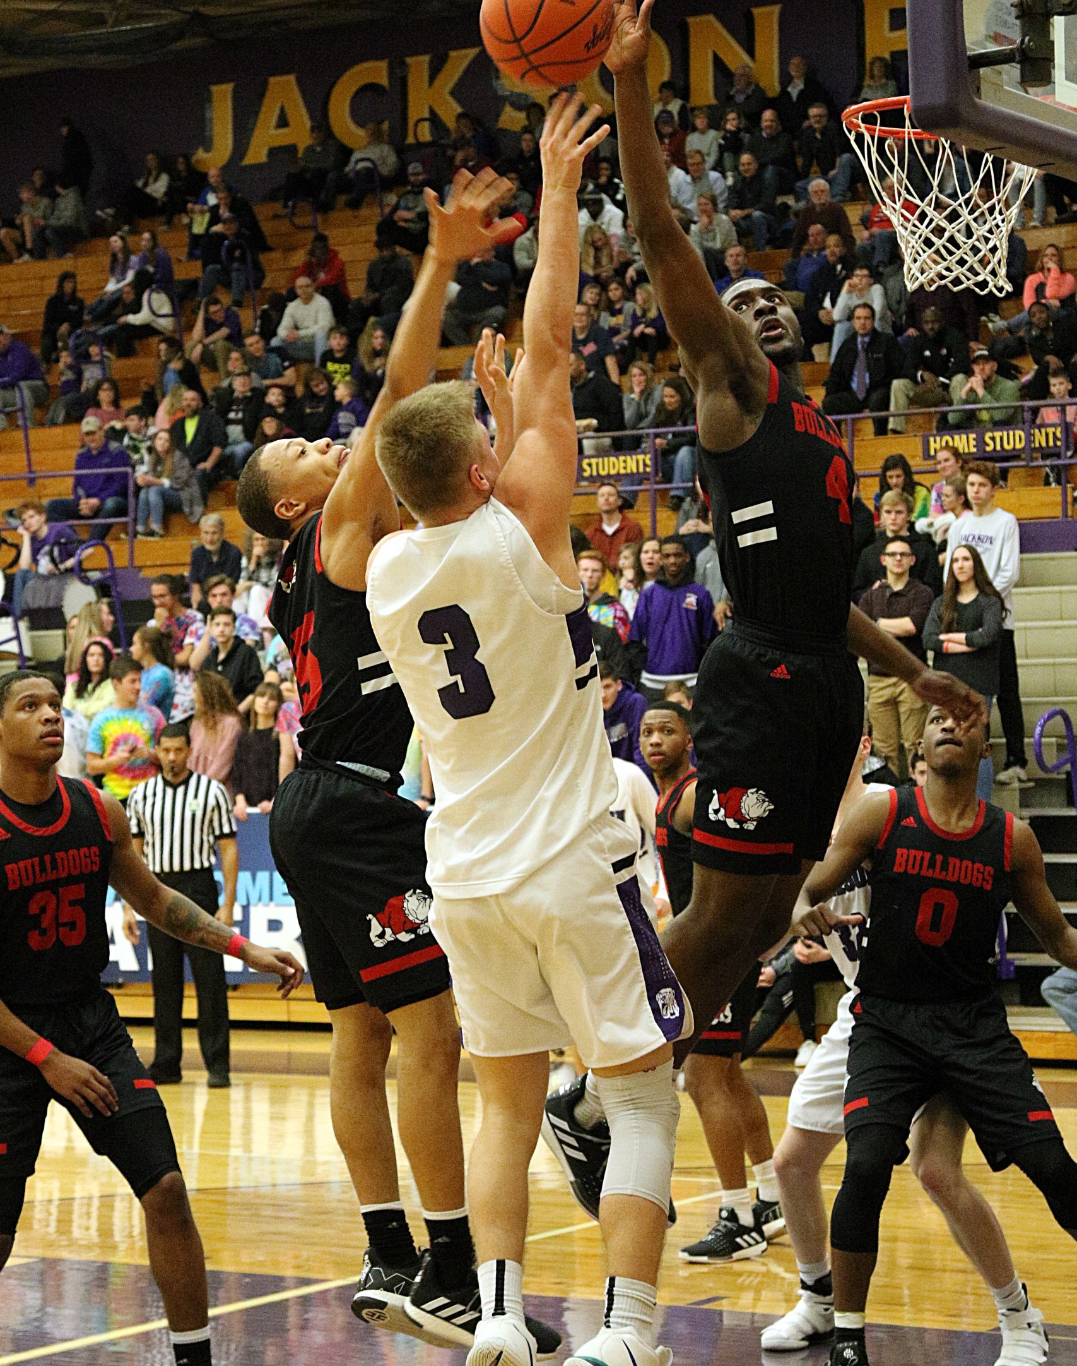

TEAM-14
Team - 14
IMAGES SOURCE : UNSPLASH.COM
Source : Unsplash.com

Slide 2

Team work is the beauty of our sport where you have five acting as one.
Marivic Tanguin
Endi Hajdari
Farman Syed
Youssouf Ismael Y.
Sunil Khambaita
TEAM MEMBERS

Slide 3
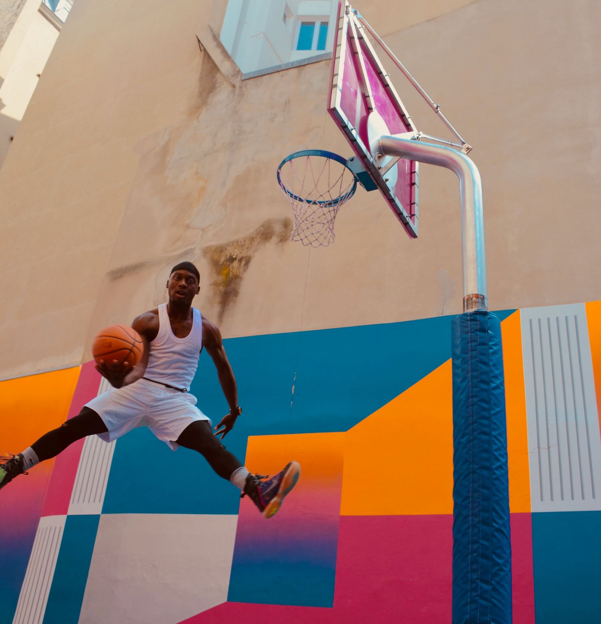
When you’re not practicing, someone else is getting better.
Project Description
TEAM - 14
The project will measure whether the draft position of an NBA player in any given year is correlated with future success.
We will try to analyze whether general managers of NBA teams do a good job of increasing their teams’ chances of success by their draft picks.
Source : Unsplash.com
IMAGES SOURCE : UNSPLASH.COM

Slide 4

Research Question
Is the pick at which a player is drafted commensurate with the value they bring to their team?
Do they bring offensive value? As measured by:
- Points - Assists
Do they bring defensive value? As measured by:
- Steals
- Blocks
Are they significant contributors to the team's wins? As measured by:
- Box plus minus - Win shares
TEAM - 14

Slide 5
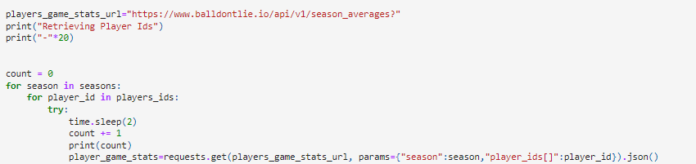
Datasets
NBA API (Balldontlie.io)
We started with this API to gather defensives stats such as Steals and Blocks. The API was not cooperative for a high number of requests; therefore we used the sleep function to delay every request.
This took hours to complete but allowed us to make 10 000+ requests to gather data on 300+ players over 32 seasons.
TEAM - 14

Slide 6
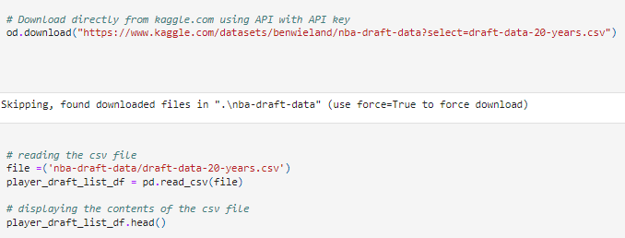
STRATEGY
MAN TO MAN team - 14 STRATEGY
DATA EXPLORATION
KAGGLE.COM
Kaggle offers the ability to download datasets directly via their public API. We gathered the rest of our player stats from this source.
TEAM - 14

Slide 7
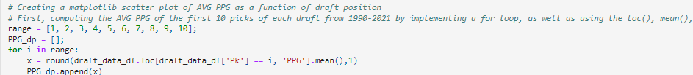
DATA CLEAN-UP
Grouping top 10 players and their key stats
TEAM - 14
We narrowed down over 20 data points for each group to 6:
Points per Game (PPG)
Assists per Game (APG)
Steals per Game (STPG)
Blocks per Game (BLKPG)
Win-Shares (WS)
Box Plus-Minus (BPM)
To make our analysis, we decided to group players by their draft picks across 32 seasons. Thus creating 10 groups to compare:
1st pick group
2nd pick group
3rd pick group
4th pick group
5th pick group
6th pick group
7th pick group
8th pick group
9th pick group
10th pick group

Slide 8
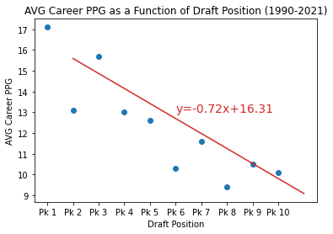
IS DRAFT PICK COMMENSURATE WITH OFFENSIVE OUTPUT?
VISUALIZATION
AVERAGE POINTS PER GAME BY DRAFT POSITION
The correlation between draft rank and PPG is strong. The following correlation is found
TEAM - 14
-0.87
R VALUE
0.001
P VALUE
This reflects the fact that, the later in the draft a player is recruited, the less points they will produce per game.
There are a few outliers to the data however:
3rd picks tend to outperform 2nd picks
7th picks tend to outperform 6th picks
9th & 10th picks tend to outperform 8th picks

Slide 9
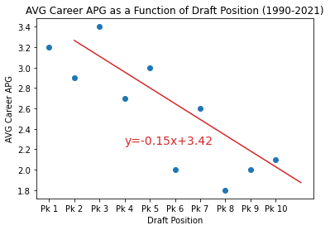
IS DRAFT PICK COMMENSURATE WITH OFFENSIVE OUTPUT?
VISUALIZATION
AVERAGE assists PER GAME BY DRAFT POSITION
The correlation between draft rank and APG is strong. The following correlation is found
TEAM - 14
-0.83
R VALUE
0.003
P VALUE
This reflects the fact that, the later in the draft a player is recruited, the less assists they will produce per game.
There are a few outliers to the data however:
3rd picks tend to outperform 1st & 2nd picks
5th picks tend to outperform 4th and 2nd picks
7th picks tend to outperform 6th picks
9th & 10th picks tend to outperform 8th picks

Slide 10
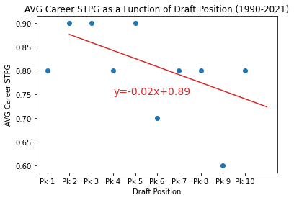
IS DRAFT PICK COMMENSURATE WITH DEFENSIVE OUTPUT?
VISUALIZATION
Average Steals PER GAME BY DRAFT POSITION
The correlation between draft rank and STPG is relatively weak. The following correlation is found
TEAM - 14
-0.54
R VALUE
0.107
P VALUE
This reflects the fact that there is not a strong relationship between draft position and the ability to produce steal within a game.
There are a few outliers to the data however:
3rd picks tend to outperform 1st & 2nd picks
5th picks tend to outperform 4th picks
7th picks tend to outperform 6th picks
9th & 10th picks tend to outperform 8th picks

Slide 11
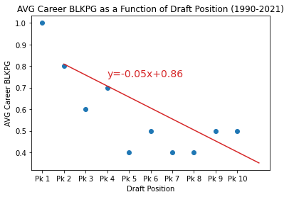
IS DRAFT PICK COMMENSURATE WITH DEFENSIVE OUTPUT?
VISUALIZATION
AVERAGE Blocks PER GAME BY DRAFT POSITION
The correlation between draft rank and BLKPG is strong. The following correlation is found
TEAM - 14
-0.77
R VALUE
0.009
P VALUE
This reflects the fact that, the later in the draft a player is recruited, the less blocks they will produce per game.
There are a few outliers to the data however:
9th picks tend to outperform 5th, 6th & 7th picks

Slide 12
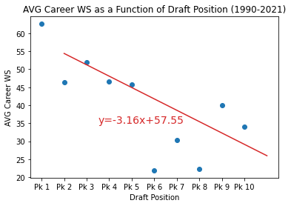
Is draft pick commensurate with contribution to wins?
TEAM - 14
VISUALIZATION
AVERAGE win-Shares PER GAME BY DRAFT POSITION
This reflects the fact that, the later in the draft a player is recruited, the less likely they are to contribute to the wins of their team.
There are a few outliers to the data however:
The correlation between draft rank and WS is strong. The following correlation is found
3rd & 4th picks tend to outperform 2nd picks
7th and 8th picks tend to outperform 6th picks
9th & 10th picks tend to outperform 6th, 7th & 8th picks
-0.73
R VALUE
0.017
P VALUE

Slide 13
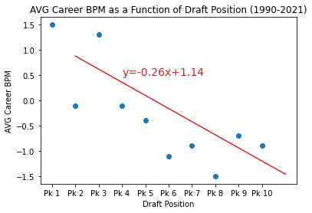
Is draft pick commensurate with contribution to wins?
VISUALIZATION
AVERAGE Box Plus-Minus BY DRAFT POSITION
The correlation between draft rank and BPG is strong. The following correlation is found
TEAM - 14
-0.79
R VALUE
0.006
P VALUE
This reflects the fact that, the later in the draft a player is recruited, the less likely they are to contribute to the offensive output of their team.
There are a few outliers to the data however:
3rd picks tend to outperform 2nd picks
7th picks tend to outperform 6th picks
9th & 10th picks tend to outperform 6th & 8th picks

Slide 14
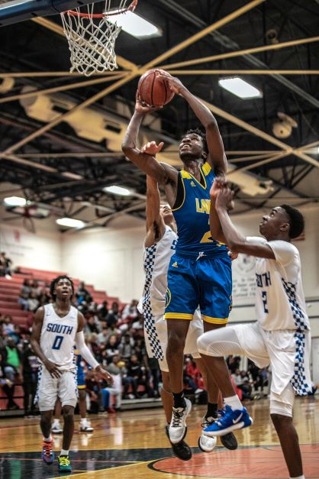
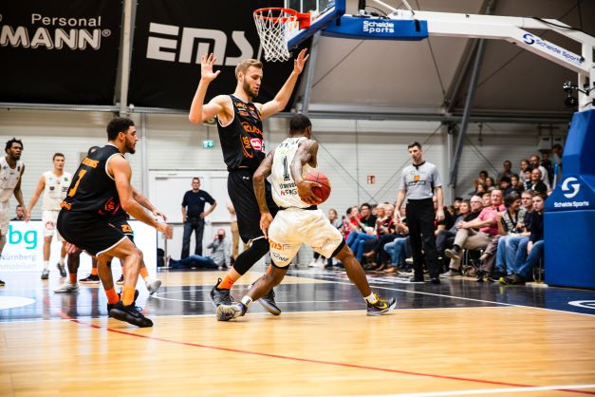

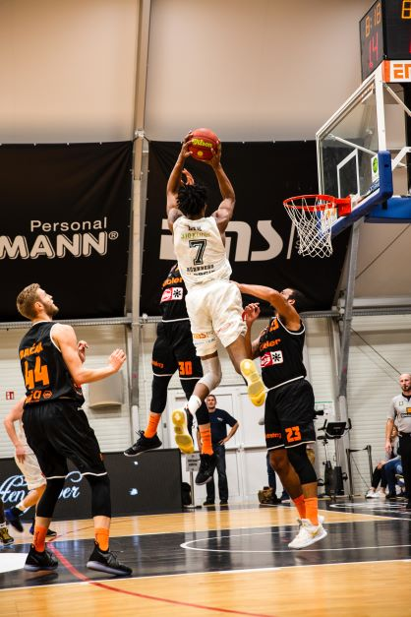
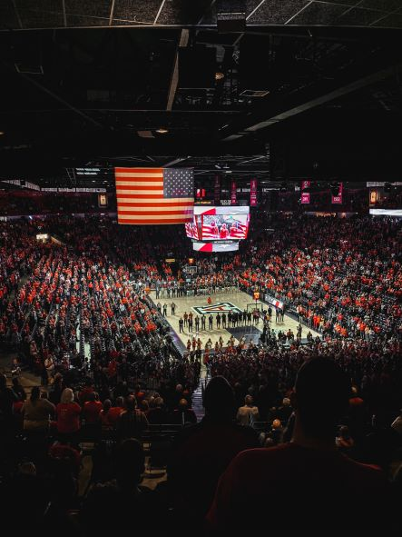
UOFT LEAGUE
LATEST RESULTS
Dec 12, 2022 | R / p Value
Points Per Game | -0.87/0.001
Assists Per Game | -0.83/0.003
Box Plus-Minus Rating | -0.79/0.006
Blocks Per Game | -0.77/0.009
Win-Shares | -0.73/0.017
Steals Per Game | -0.54/0.107
TEAM - 14
IMAGES SOURCE : UNSPLASH.COM

Slide 15
Is draft pick commensurate with player performance?
We found strong correlation with draft position and player performance across all vectors. Our analysis did find that teams picks tend to optimize for offensive output, less so for team wins and defensive output.
We can say conclusively that general managers of teams do a good job of predicting future offensive performance via triage of players during drafts.
We also believe the nature of the draft affects these stats.
We also believe there are several limitations to this study such as positional data and more advanced stats. The most advanced stats are not available for longer time horizons and player performance is dependent on positions.
There are also the ‘’intangibles’’ inherent in any sports.
Conclusion
conclusion
TEAM - 14

Slide 16

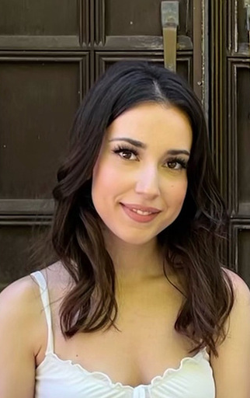



THANK YOU
FROM TEAM - 14
TEAM - 14
MARIVIC TANGUIN
Endi Hajdari
Youssouf Ismael Y.
Farman syed
Sunil Khambaita
SHOOTING GUARD
POINT GUARD
POWER FORWARD
SMALL FORWARD
CENTER
If you are afraid of failure you don’t deserve to be successful

Slide 17
Questions?

